Slide 1
Team 83 Presentation - Using RNN models for early detection of heart failure onset
Team members:
Sagar Dalwadi
Murtaza Lodgher

Slide 2



Introduction
Heart failure (HF) is a difficult disease to detect early on, as many as many of the early signs and symptoms are common across different kinds of common diseases
The “onset of HF is associated with a high level of disability, health care costs, and mortality” (Choi et al., 2017, pg. 362)
Our chosen paper explores how RNN models can be used to detect HF as early as possible, more so than conventional DL methods

Slide 3
Scope of Reproducibility and Ablations
Main Claim: RNN models using gated recurrent units (GRUs) were able to yield a higher area-under-the-curve (AUC) for predicting HF diagnoses through electronic health record (EHR) data over conventional deep learning methods, like logistic regression, SVM and KNN.
Our ablation to the original code we implemented is changing the activation function of the GRU to see if the accuracy differs

Slide 4
Data description
Data sets are extracted from PhysioNet website, which includes the following:
Admissions: gives information regarding a patient’s admission to the hospital
Patients: Provides information on each patient
Diagnoses ICD: Contains ICD diagnoses for patients
ICU Stays: defines a single ICU stay
Lab events: Contains all laboratory measurements for a given patient

Slide 5
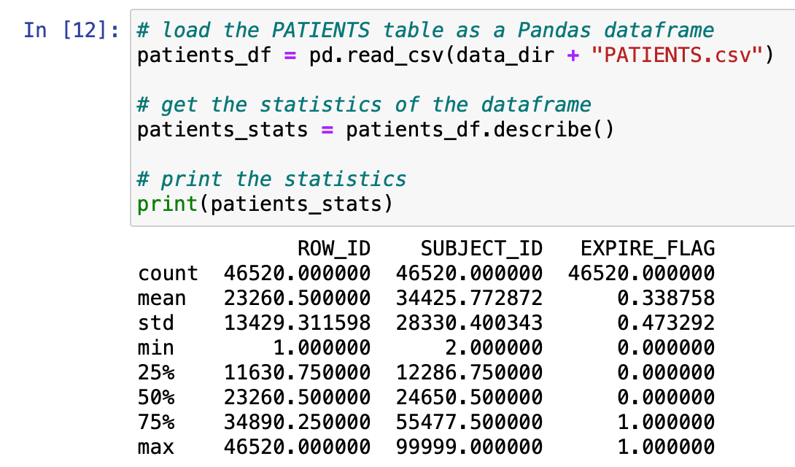
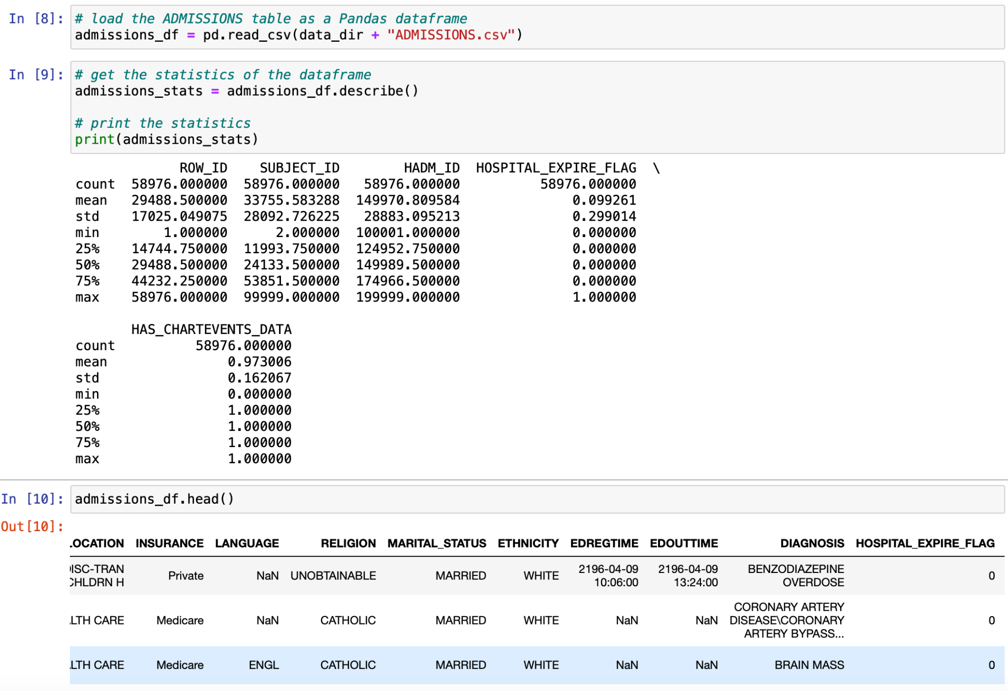
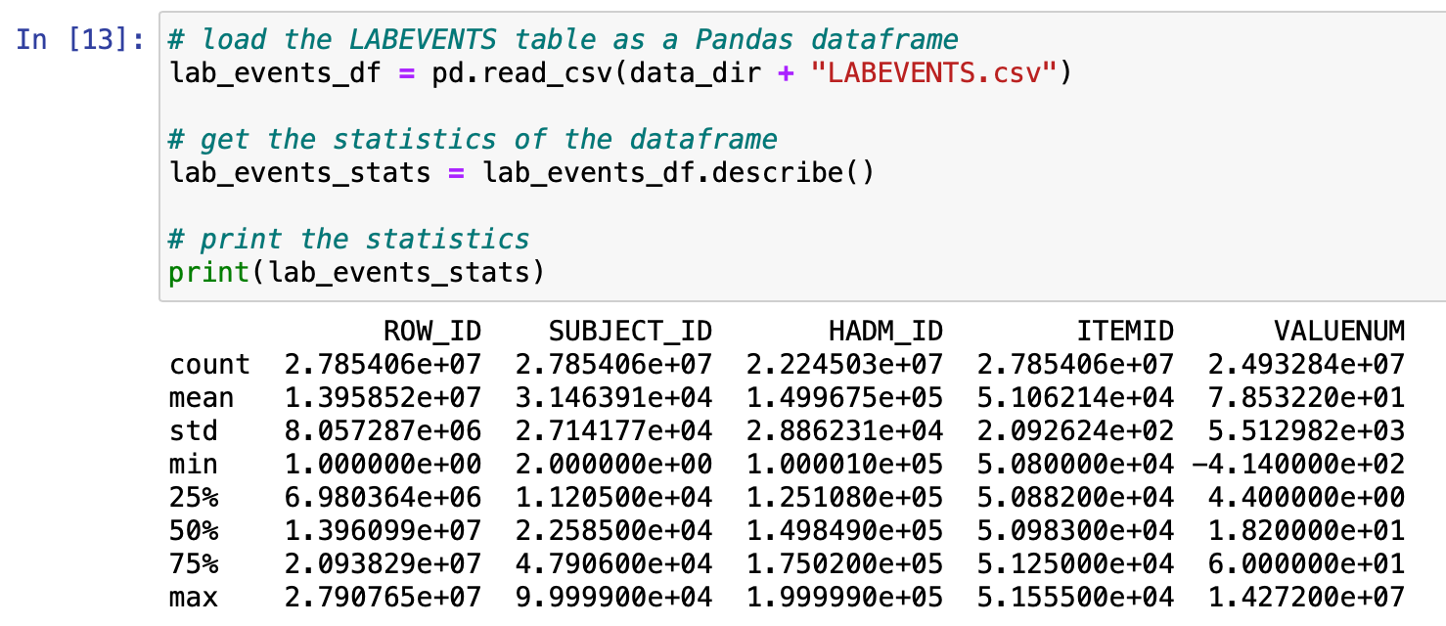
Data Statistics

Slide 6
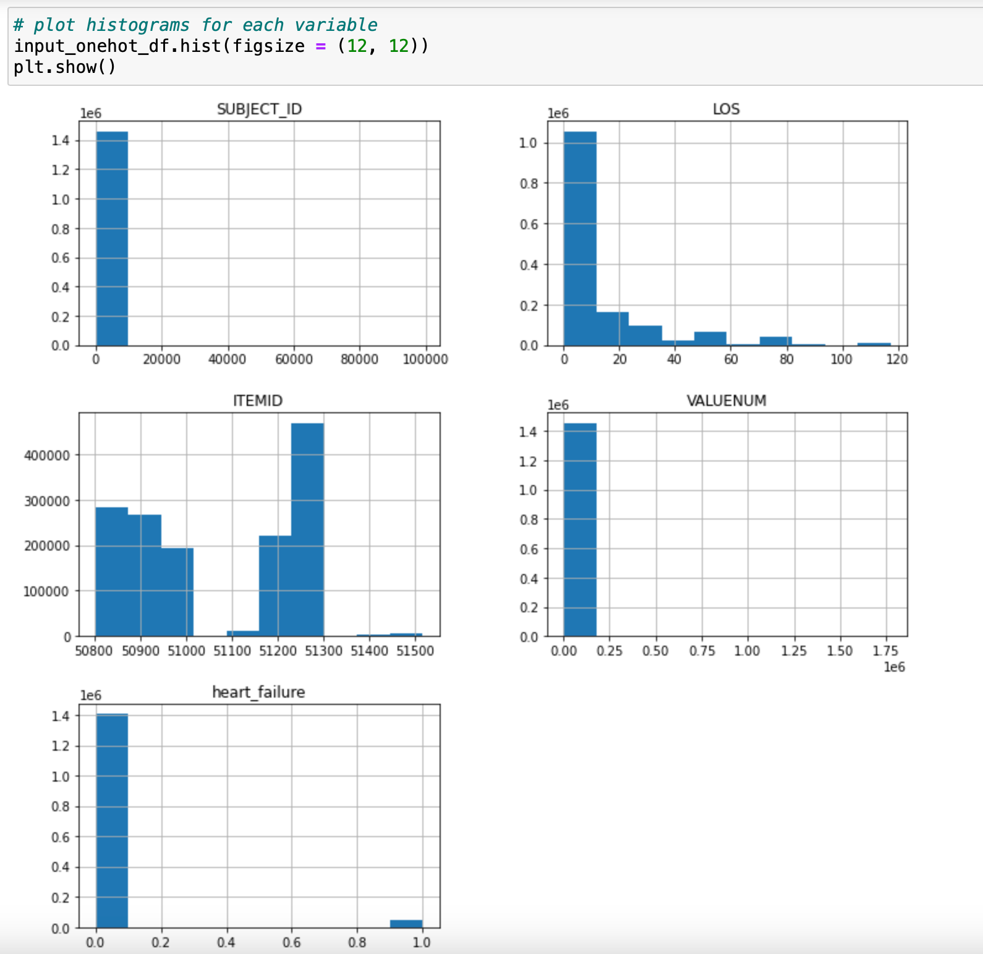
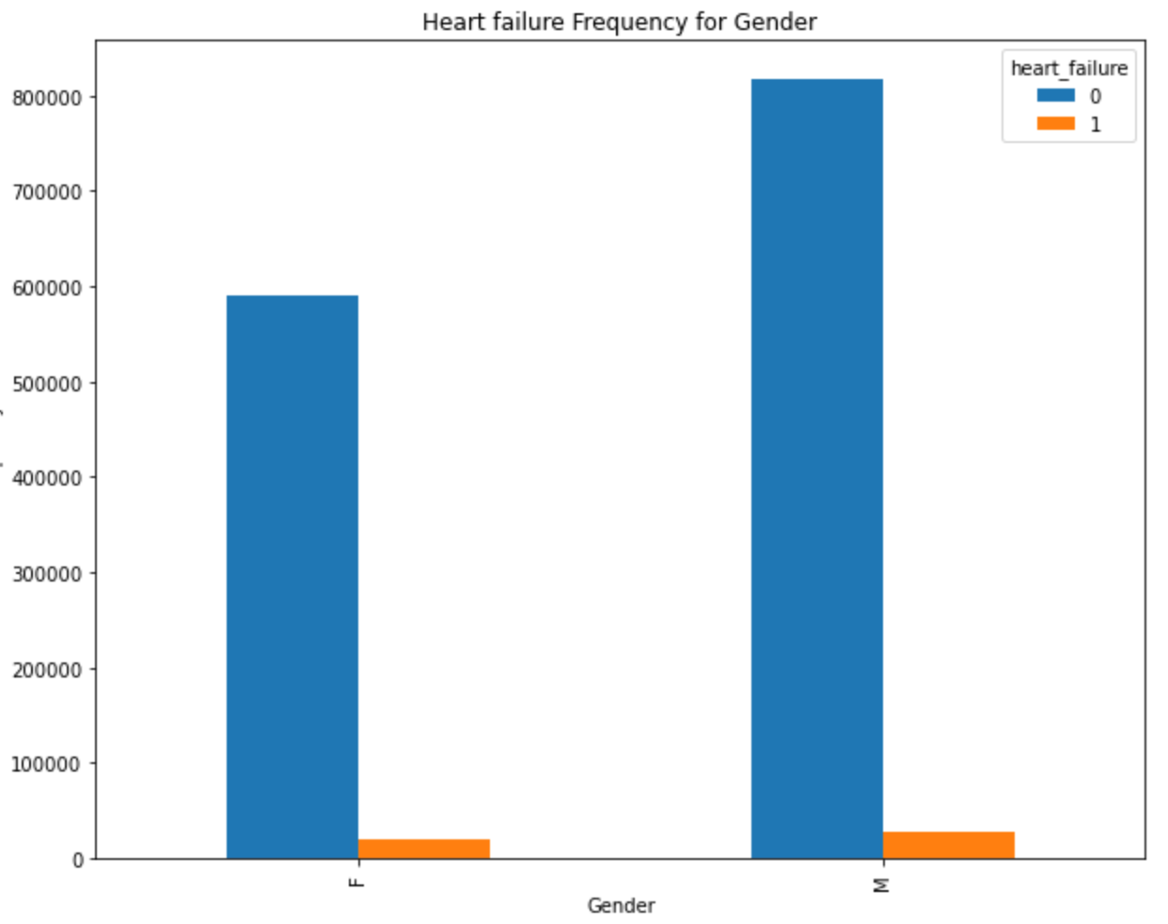
Data Statistics (cont.)

Slide 7
Implementation
Our implementation was original code written by our team members
Step 1: Read data files
Step 2: Apply one hot vector encoding to data
Step 3: Split data to training and testing datasets
Step 4: Build the model with ablations
Ablation 1: ReLU activation
Ablation 2: Sigmoid activation
Step 5: Compile and Train the model
Step 6: Model evaluation

Slide 8
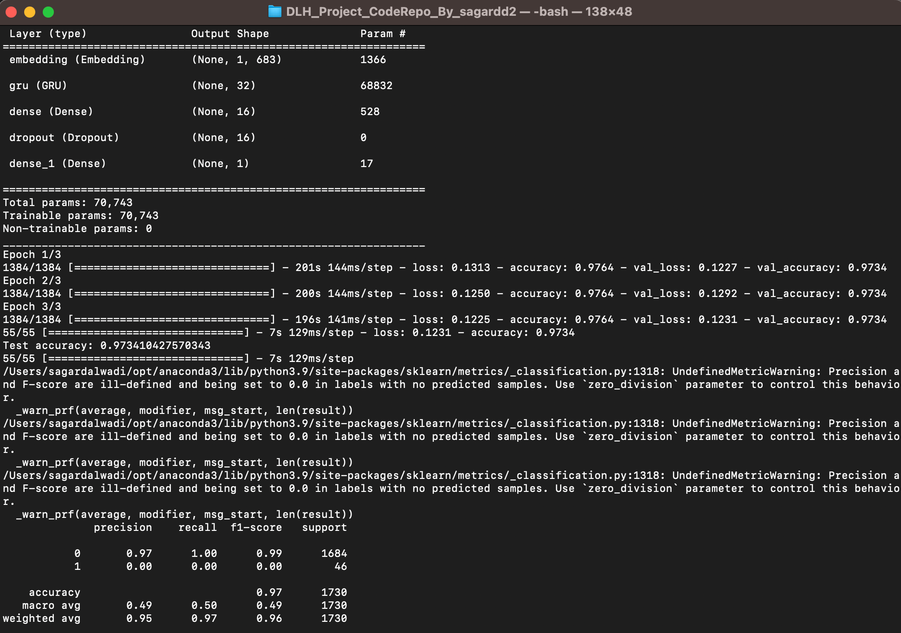
Results
The results from this image are from a GRU with a ReLU activation function. This shows an accuracy of 0.97, with 3 epochs. This shows a high prediction factor for HF in the data

Slide 9
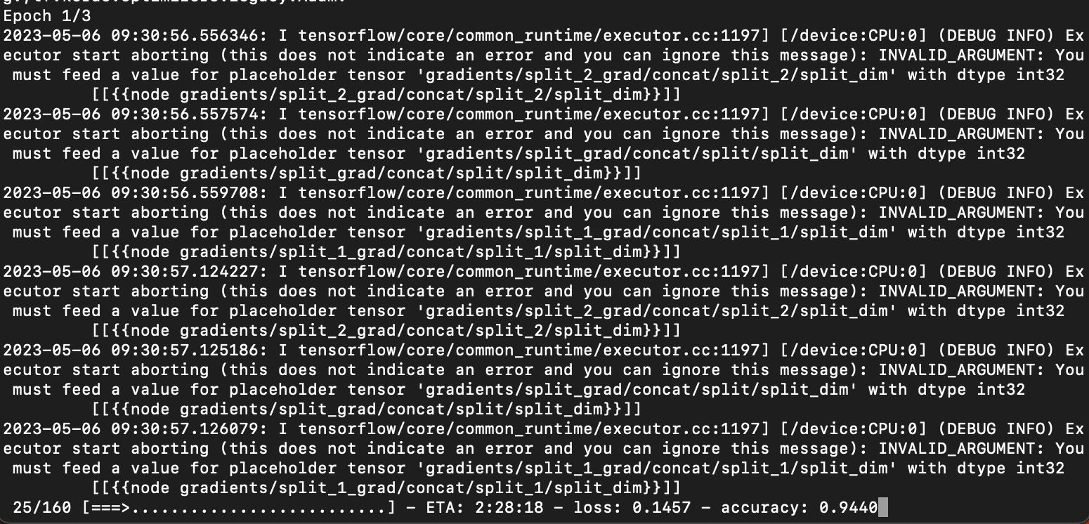
Results (cont.)
The results from this image are from a GRU with a Sigmoid activation function. This shows an accuracy of 0.94, with 3 epochs. This shows a high prediction factor for HF in the data, although slightly lower than with the ReLU activation.

Slide 10
Results (cont.)
Model | Accuracy | Note
Logistic Regression | 0.7467 | These data were taken from the original paper. This is reading data from a 12 month observation window
SVM | 0.7435
GRU (from paper) | 0.7768
GRU (from implementation) | 0.9734

Slide 11
References
Choi, E., Schuetz, A., Stewart, W. F., & Sun, J. (2017). Using recurrent neural network models for early detection of heart failure onset. Journal of the American Medical Informatics Association : JAMIA, 24(2), 361–370. https://doi.org/10.1093/jamia/ocw112
https://physionet.org/content/mimiciii/1.4/
https://mimic.mit.edu/docs/iii/tables/
https://github.com/mp2893/rnn_predict

Slide 12
THANK YOU!

